Slide 1
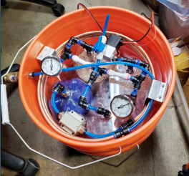
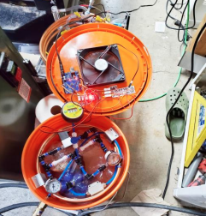
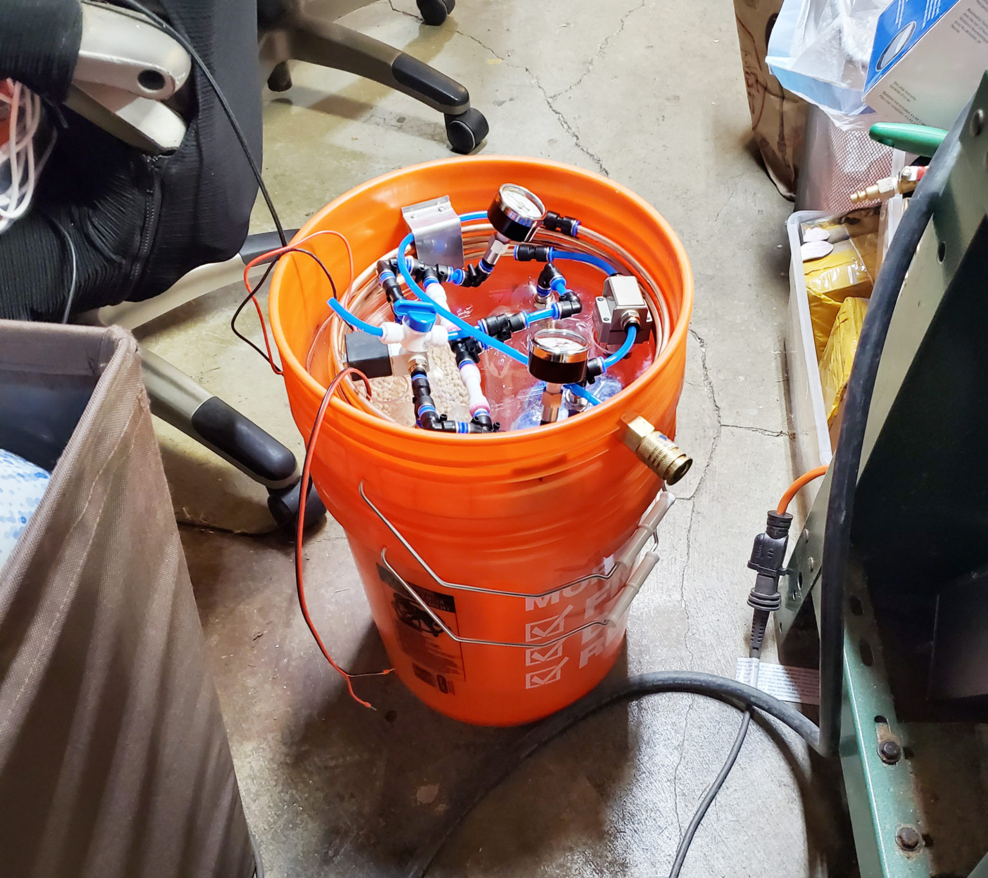
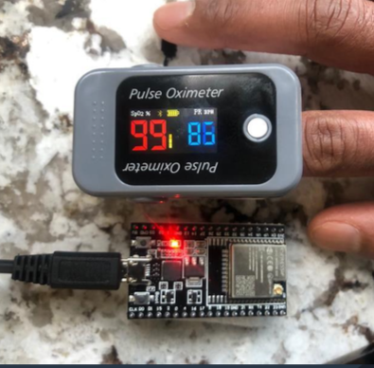
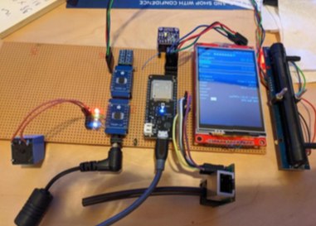
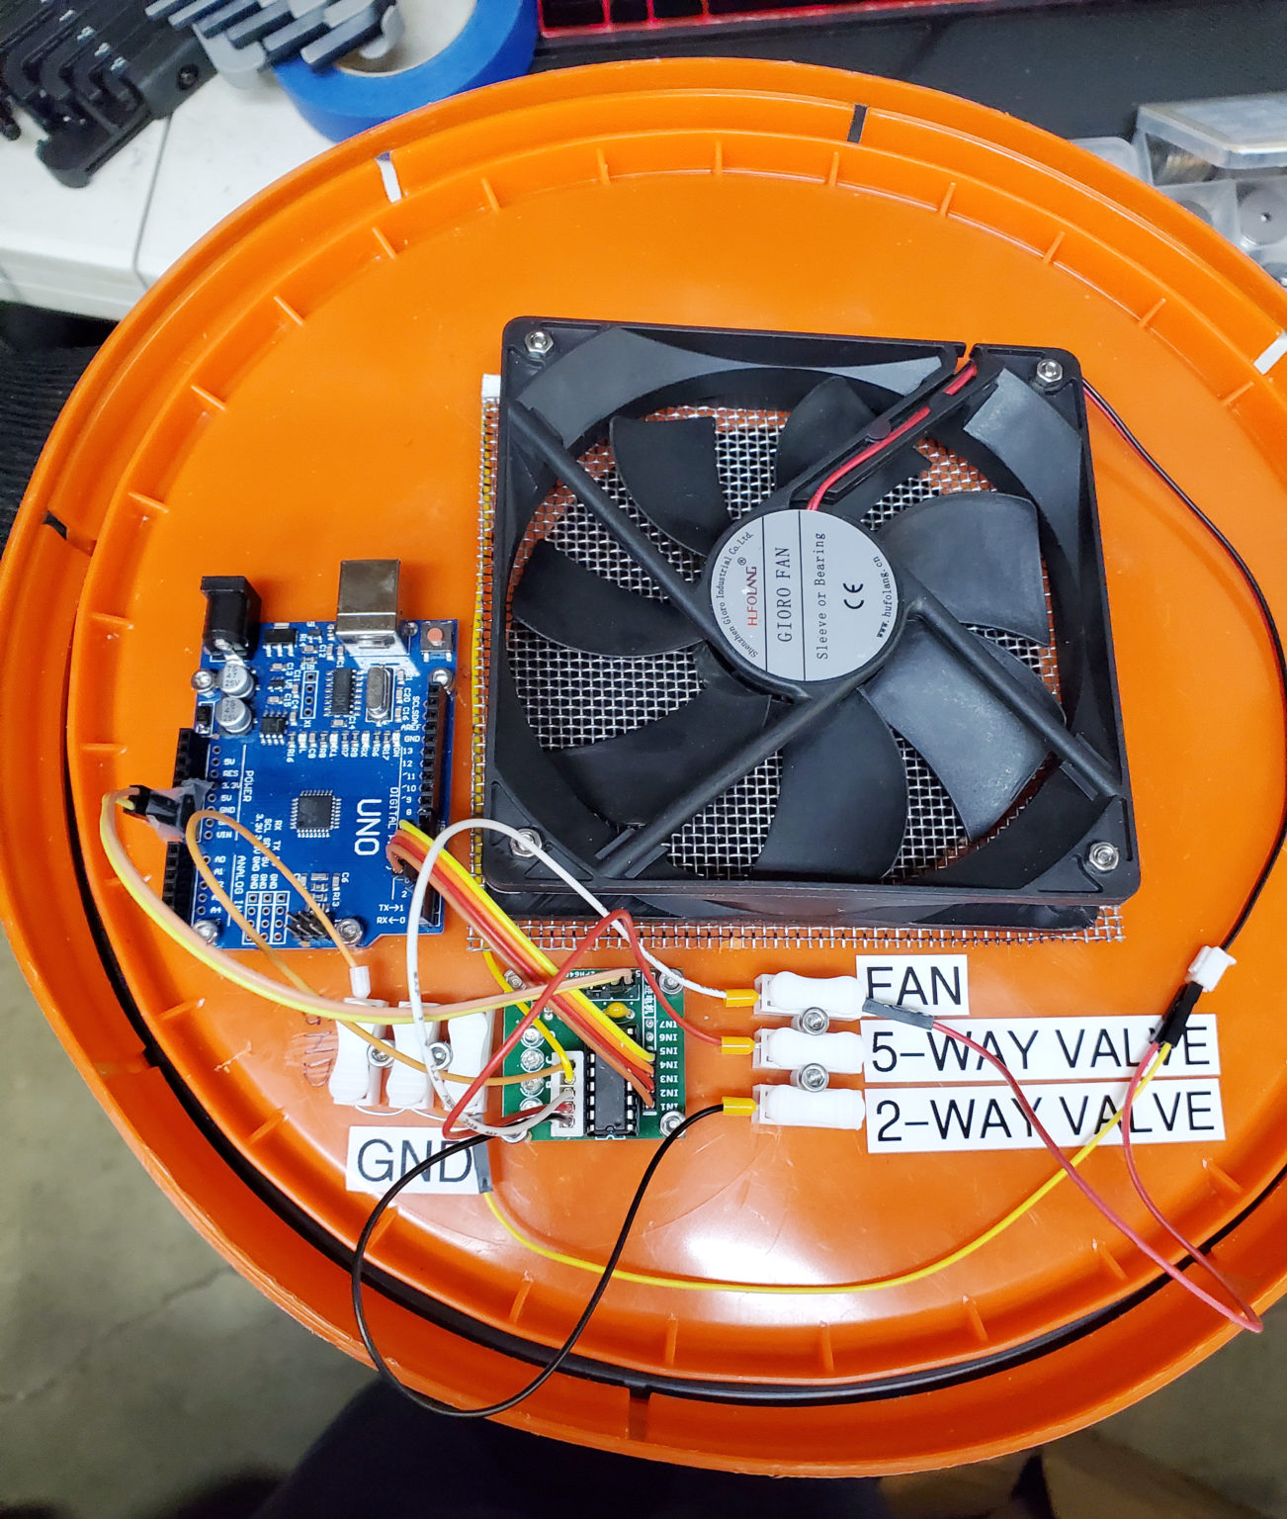
Product: Apollo O2 Concentrator
Description
O2 Concentrator: Simple, reliable design (zeolite-based PSA system). Flexible, open source, using off-the-shelf materials
Differentiators
Very low cost (aspirational target = $250 for 15 liters/min @ 90%) – current BOM cost range on prototypes have been $260-450 with retail ordered parts and components (not including cost of compressor and oxygen sensor) Safety & Usability: Detect all failure scenarios, User experience and maintainability. Clear, actionable error messages, Alarm sensors Self-regulating: Patient sensor/data feedback loop Touch screen for diagnostic messages, medical-grade buzzer, large 2.5" OLED screen, localizable messages in any locale/character set Open source, modular PCB design. Works with a variety of sensors Self-tuning: valve timing, timing adapts in changes in temperature, variations in physical dimensions, zeolite age, auto-adjusts to changes in compressed air input pressure, machine learning. Integration with SpO2 oximeter Bluetooth sensor Cloud data integration for patient monitoring Built-in compressor, self contained enclosure – humidity and dirt control, optimized airflow, thermals/cooling and noise reduction
Product Quality Standards and Prototype Readiness
Compatible and adaptable with the Indian Supply Chain driven BOM Compliant with new Indian Govt. guidelines on O2 Concentrator Feature sets Can be assembled in a lead time of 4-5 hours given availability of parts

Slide 2
Product: Apollo O2 Concentrator Key Advantages for an Indian Context
Compliant design: Meets recent government guidelines on O2 Concentrator design features and capabilities
Supply Chain Resilience: open-source, modular solution. Critical parts such as HEPA filters, silica gel, medical-grade oil free compressor and zeolite can be sourced locally, or anywhere with minimal re-testing required. Rapid assembly.
Technology transfer: Enable Indian manufacturing participants to build and improve upon locally for Indian climactic conditions against a reference design
Trust through Telemetry: Quality, safety, and effectiveness will be transparently trustworthy through direct measurement rather than design perfection. Building on direct, cloud-enabled, IoT-enabled measurement of all relevant performance characteristics we already have, will provide quality and safety visibility on each device implementation, and as oxygen concentrators are used and reused on multiple patients. Trust through telemetry provides maximum confidence when making minor part changes required by stressed supply chains.
Rapid manufacture, low cost, scalable across Indian climactic contexts

Slide 3





Product: Apollo O2 Concentrator Engineering Design Partners

